Slide 1
Immuno-oncology Comes of Age: Immunotherapy in the Clinic
Mario Sznol, MD
Yale Cancer Center
New Haven, Connecticut

Slide 2
Cancer Immune Therapies in the Clinic
Cytokines: Interleukin-2 and Interferon-Alfa
Cell Therapies and Cancer ‘Vaccines’
Sipuleucel-T in prostate cancer
Allogeneic bone marrow transplant
Immune Checkpoint Inhibitors
Ipilimumab (anti-CTLA-4)
Pembrolizumab (anti-PD-1)
Nivolumab (anti-PD-1) (pending FDA approval)

Slide 3
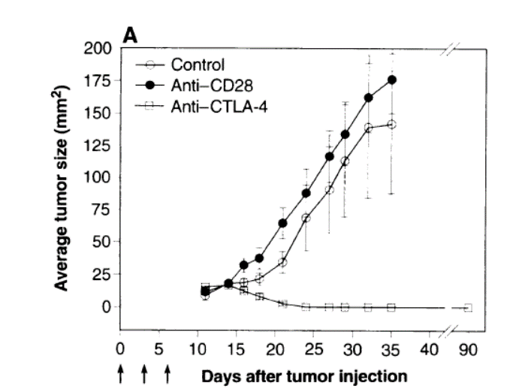

Blocking CTLA-4 Ligation Augments Immune Responses
1.
Co-stimulation via CD28 ligation transduces T cell activating signals
2.
CTLA-4 ligation on activated T cells down-regulates T cell responses
3.
Blocking CTLA-4 ligation enhances T cell responses
T cell Activation
T cell Inactivation
T cell Activation
T cell
CTLA-4
T cell
T cell
CTLA-4
TCR
TCR
CTLA-4
TCR
MHC
CD28
MHC
CD28
MHC
CD28
B7
B7
B7
APC
Anti-CTLA4 mAb (ipilimumab, tremelimumab)
APC
APC

Slide 4
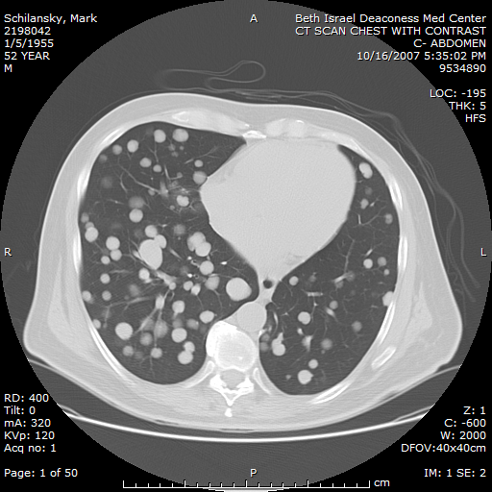
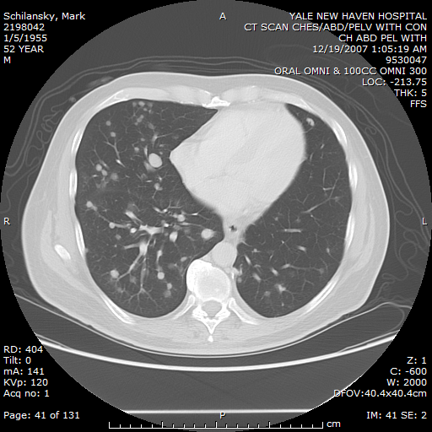
Response to Ipilimumab 10 mg/kg x 2 doses
2 baseline brain mets regressed also:
No disease progression 5+ years

Slide 5
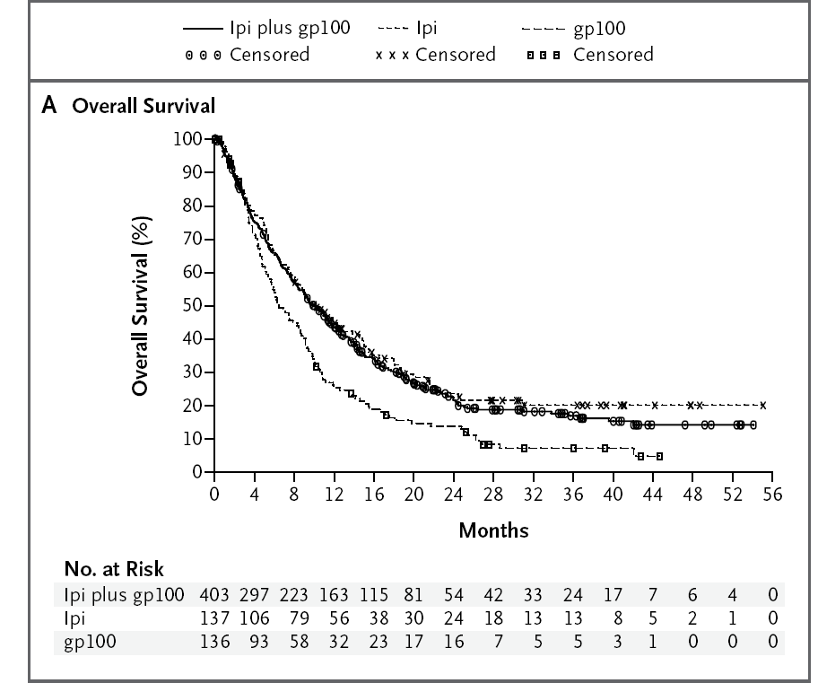
Randomized Trial of Ipilimumab +/- gp100 Vaccine Versus Vaccine in Metastatic Melanoma
Survival Rate | Ipilimumab + gp100 | Ipilimumab alone | gp100 alone
1-yr | 44% | 46% | 25%
2-yr | 22% | 24% | 14%
Hodi FS, et al. N Engl J Med. 2010;363(8):711-723.

Slide 6
Key Aspects of Immune Checkpoint Therapy
Can be associated with autoimmune adverse events
Any organ, but rash, colitis, hepatitis and endocrinopathies are most common
May require steroids +/- additional immunosuppressive agents
Ipilimumab + anti-PD-1> ipilimumab > anti-PD-1
Unique kinetics of response in some patients
SD with slow, steady decline in total tumor volume
Response after initial increase in total tumor volume
Response in index plus new lesions at or after the appearance of new lesions
Continued benefit after Rx of discordant progressing lesions
Possibility of second response with re-induction after PD

Slide 7


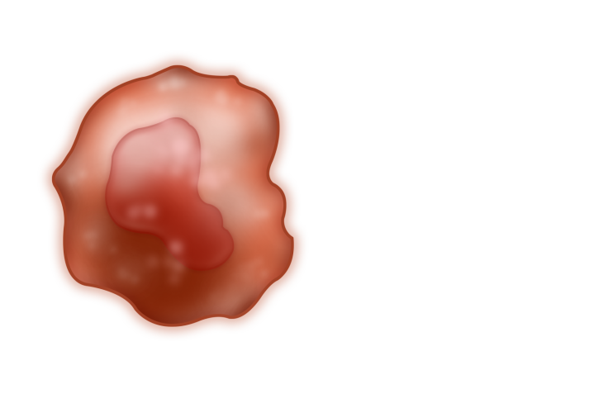

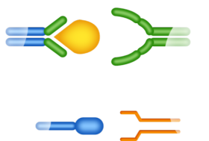
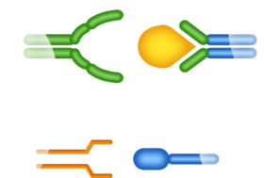




Role of PD-1 Pathway in Suppressing Anti-tumor Immunity
Recognition of tumor by T cell through MHC/antigen interaction mediates IFNγ release and PD-L1/2 up-regulation on tumor
Priming and activation of T cells through MHC/antigen & CD28/B7 interactions with antigen-presenting cells
IFNγ
IFNγR
T-cell receptor
T-cell receptor
MHC
MHC
PI3K
Dendritic cell
Tumor cell
NFκB
Other
CD28
B7
PD-L1
Shp-2
T cell
PD-L2
PD-1
PD-1
PD-L1
Shp-2
PD-1
PD-1
PD-L2
7

Slide 8
Clinical Activity of Nivolumab (Phase 1 Multi-Dose Trial)
Dose mg/kg | ORR % (n/N) | Estimated Median DOR Weeks (Range) | Stable Disease Rate ≥24 Wks % (n/N) | Median PFS Months (95% CI)
NSCLC | 17 (22/129) | 74 (6+, 134+) | 10 (13/129) | 2 (2, 4)
MELª | 31 (33/107) | 104 (18, 117+) | 7 (7/107) | 4 (13, 44)
RCCª | 29 (10/34) | 56 (37, 127+) | 27 (9/34) | 7 (4, 13)
CI = confidence interval; DOR = duration of response; NE = not estimable; ORR = objective response rate; OS = overall survival; PFS = progression-free survival ª1 CR was noted in MEL and 1 CR was noted in RCC.
30/65 (46%) responses were evident at first tumor evaluation (8 weeks)
42/65 (65%) responses were ongoing >1 year
No OR in CRPC or CRC
Topalian SL, et al. N Engl J Med. 2012;366:2443-2454.

Slide 9
Overall Survival for Patients with Melanoma Treated with Nivolumab
100
Died/Treated | Median OS, mo (95% CI)
64/107 | 17.3 (12.5, 36.7)
Censored
90
OS | Pts at risk, n | Rate, % (95% CI)
6 Mo | 86 | 82 (74, 88)
1 Yr | 63 | 63 (53, 71)
2 Yr | 44 | 48 (38, 57)
3 Yr | 22 | 41 (31, 51)
80
70
60
1 year OS 63%
Overall Survival (%)
2 year OS 48%
50
40
30
20
3 year OS 41%
10
0
0
3
6
9
12
15
18
21
24
27
30
33
36
39
42
45
48
51
54
57
Patients at Risk
Total
Months Since Treatment Initiation
107
97
86
71
63
54
50
47
44
31
25
22
22
19
18
9
3
2
1
0
Hodi FS, et al. J Clin Oncol. 2014;32(5s): Abstract 9002.

Slide 10
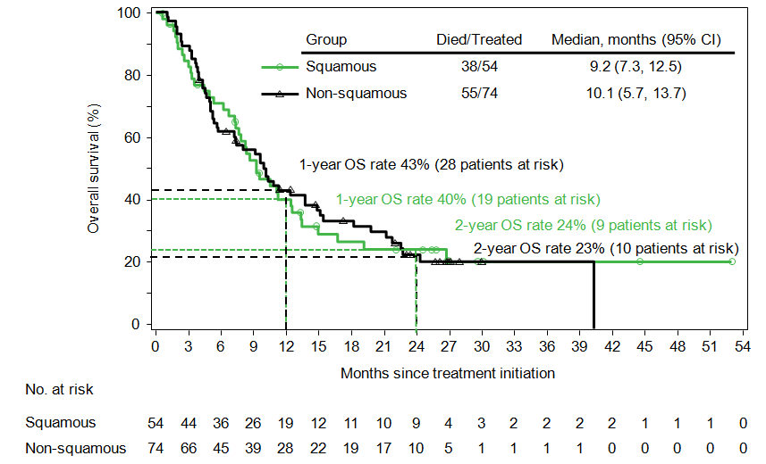
Nivolumab OS by Histology in NSCLC patients
Brahmer JR, et al. J Clin Oncol. 2014;32(5s): Abstract 8112.

Slide 11
Nivolumab Multi-Dose: Safety in Total Population CA209-003
Drug-related AEs: all grades, 75%; grades 3–4, 17%
Drug-related select AEs: all grades, 46%; grades 3–4, 6%
Select AEs | Any Grade n (%) | Grade 3–4, n (%)
Any select AEs | 140 (45.8) | 19 (6.2)
Skin | 75 (24.5) | 1 (0.3)
Rash | 45 (14.7) | 0
Pruritus | 32 (10.5) | 1 (0.3)
Rash pruritic | 7 (2.3) | 0
Urticaria | 6 (2.0) | 0
Photosensitivity reaction | 5 (1.6) | 0
Rash macular | 4 (1.3) | 1 (0.3)
Gastrointestinal | 44 (14.1) | 3 (1.0)
Diarrhea | 41 (13.4) | 3 (1.0)
Colitis | 6 (2.0) | 2 (0.7)
Endocrinopathies | 29 (9.5) | 3 (1.0)
Blood thyroid-stimulating hormone increased | 11 (3.6) | 1 (0.3)
Hypothyroidism | 11 (3.6) | 1 (0.3)
Hyperthyroidism | 4 (1.3) | 1 (0.3)
Hepatic | 18 (5.9) | 4 (1.3)
Alanine aminotransferase increased | 11 (3.6) | 1 (0.3)
Aspartate aminotransferase increased | 9 (2.9) | 0
Pulmonary | 17 (5.6) | 6 (2.0)
Pneumonitis | 12 (3.9) | 4 (1.3)
Infusion reaction | 15 (4.9) | 2 (0.7)
Infusion-related reaction | 12 (3.9) | 0
Hypersensitivity | 4 (1.3) | 2 (0.7)
Renal | 6 (2.0) | 1 (0.3)
Blood creatinine increased | 4 (1.3) | 1 (0.3)
Topalian SL, et al. N Engl J Med. 2012;366:2443-2454.

Slide 12
Activity of Anti-PD-1 and Anti-PD-L1 in
Metastatic Melanoma
Agent | Dose and schedule | N= | ORR (%) | Median response duration, months | Median PFS/ 24 week PFS rate | Median Survival | 1 yr/2 yr survival
Nivolumab (Anti-PD1) | 0.3-10 mg/kg q2w | 107 | 32% | 22.9 | 3.7 months | 17.2 months | 63%/48%
Pembrolizumab (Anti-PD1) | 2-10 mg/kg q2-3w | 411 (168 ipi-N) | 34% (40% IPI-N) | NR | 5.5 months | NR | 69%/ND
MPDL3280 (Anti- PD-L1) | .01-20 mg/kg q3w | 44 | 29% | ND | 43% | ND | ND
BMS-936559 (Anti- PD-L1) | 0.3-10 mg/kg q2w | 52 | 17% | ND | 42% | ND | ND
Topalian/Sznol et al, JCO 2014; Robert/Ribas et al; Herbst/Hamid et al;

Slide 13
Activity of Anti-PD1 and Anti-PD-L1 in NSCLC
Agent | Dose mg/kg | N= | ORR % (n/N) | Estimated Median DOR Weeks (Range) | PFS rate at 24 weeks | Median PFS Months (95% CI) | Median OS Months (95% CI) | 1 yr/2yr survival rate
Nivolumab Anti-PD-1 | 1-10 mg/kg q2w | 129 | 17.1% | 74.0 | ND | 2.3 | 9.9 | 42%/24%
Pembrolizumab Anti-PD-1 | 2-10 mg/kg q2-3w | 146 | 19% | ND | ND | Approx 2.5 | Approx 8 | ND
MPDL3280A Anti-PD-L1 | .01-20 mg/kg q3w | 53 | 23% | ND | 46% | ND | ND | ND
BMS-936559 Anti-PD-L1 | 1-10 mg/kg q2w | 49 | 10% | ND | 31% | ND | ND | ND
Medi-4736 Anti-PD-L1 | 0.1 -10 mg/kg q2w | 84 | ~16% | ND | ND | ND | ND | ND

Slide 14
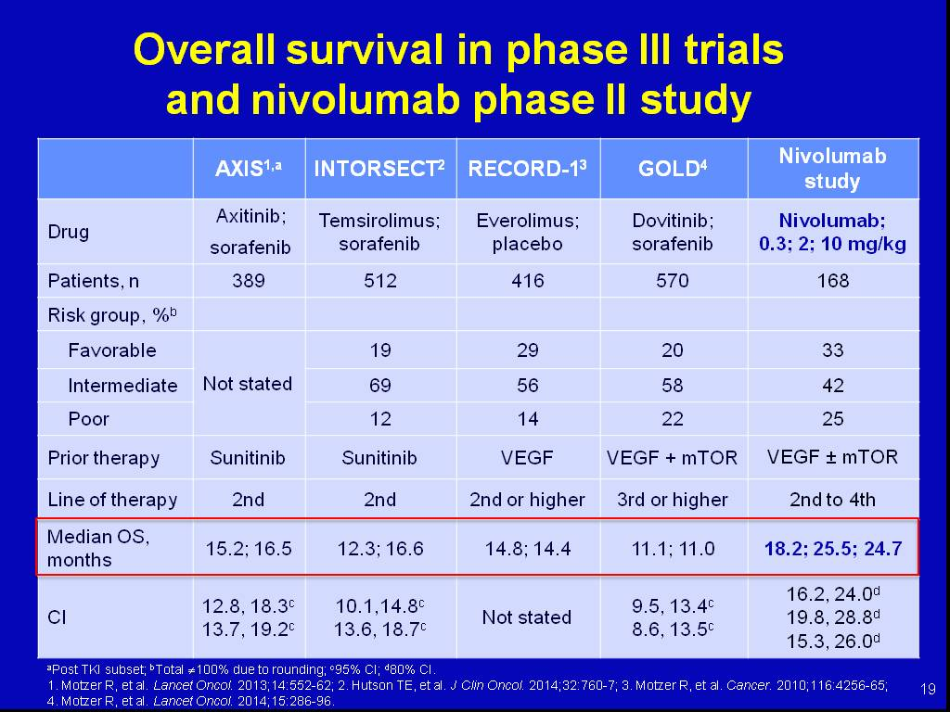
Slide 19
Randomized Phase 2 Trial of Nivolumab in Metastatic Renal Cancer
Nivolumab
ORR ~ 20%
Presented By Robert Motzer at 2014 ASCO Annual Meeting

Slide 15
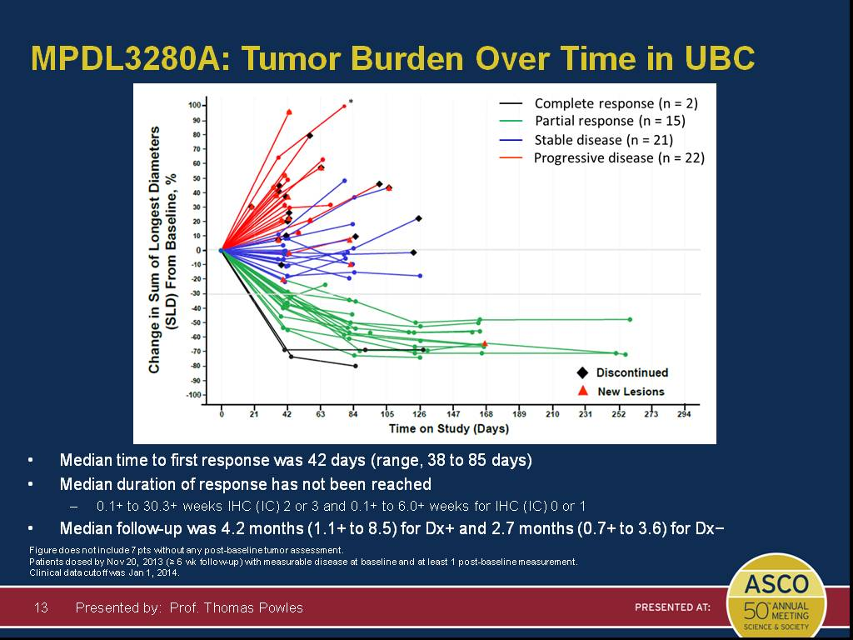
MPDL3280A: Tumor Burden Over Time in UBC
Promising Activity of Anti-PD-L1 in Advanced Bladder Cancer
Presented By Thomas Powles at 2014 ASCO Annual Meeting

Slide 16
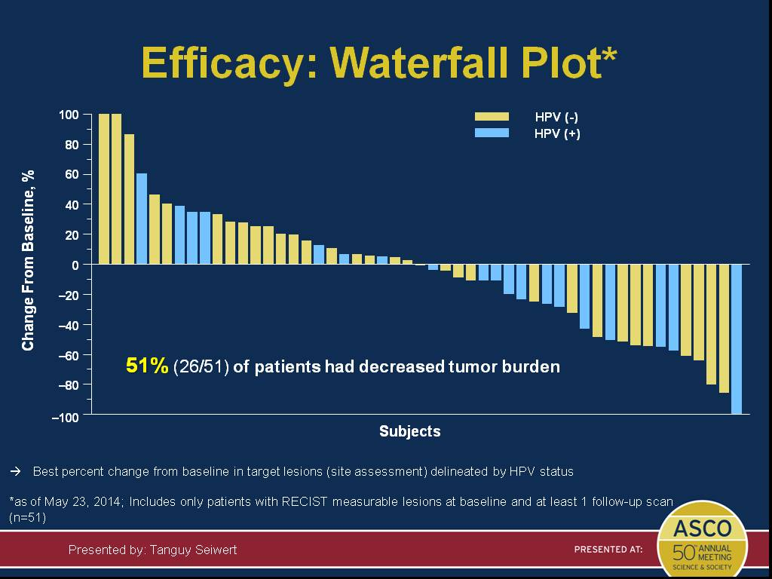
Efficacy: Waterfall Plot*
Activity of Pembrolizumab in PD-L1+ Squamous Cell Cancer of Head and Neck
Presented By Tanguy Seiwert at 2014 ASCO Annual Meeting

Slide 17
Activity of Anti-CTLA-4 and/or Anti-PD1 in Multiple Cancers
Melanoma
Renal Cancer
Non-small cell lung cancer
Bladder cancer
Head and neck
Gastro-esophageal
Ovarian
Mesothelioma (anti-CTLA-4)
Hodgkin’s Disease

Slide 18
CA209-004 Ipilimumab/Nivolumab Combination Phase I Study: Dose Cohorts
 |  | Dose (mg/kg), |  | Treatment Schedule
Regimen Cohort No. | N | Nivolumab | Ipilimumab | Induction | Maintenance
Concurrent 1 2 2a 3 | 14 17 16 6 | 0.3 1 3 3 | 3 3 1 3 | Nivo Q3W x 8 + IPI Q3W x 4 | Nivo + IPI Q12W x 8
8* | 41 | 1 | 3 | Nivo Q3W x 4 + IPI Q3W x 4 | Nivo 3 mg/kg Q2W (Max. 48 doses)
Sequenced 6 7 | 17 16 | 1 3 | Prior Prior | Nivo Q2W (Max of 48 doses)
*Insufficient follow-up at this data collection to report survival endpoints
Wolchok JD, et al. N Engl J Med. 2013;369:122-133.

Slide 19
Activity Summary: Concurrent and Sequenced Cohorts from 004
Nivolumab (mg/kg) + IPI (mg/kg) | N | ORRª, % | CR, % | Aggregate Clinical Activity Rate | ≥80% tumor burden reduction at 36 wks^{b}, %
Concurrent Cohorts 1-3 | 53 | 42 | 17 | 70 | 42
0.3 + 3 | 14 | 21 | 14 | 57 | 36
1 + 3 | 17 | 53 | 18 | 65 | 53
3 + 1 | 16 | 44 | 25 | 81 | 31
3 + 3 | 6 | 50 | 0 | 83 | 50
1 + 3 [Cohort 8]^{c} | 40 | 43 | 10^{d} | 53 | 28
Sequenced | 33 | 31 | 3 | 44 | 31
ªper RECIST, [CR+PR]/N x 100; ^{b} Best overall response; ^{c}Cohort 8: Phase 2/3 trial; last patient, first dose Nov 2013. ^{d}2 confirmed and 2 unconfirmed responses n: no. response-evaluable pts.
Wolchok JD, et al. N Engl J Med. 2013;369:122-133.

Slide 20
Overall Survival for Concurrent Therapy by Dose Cohort
100
1 Yr OS 94%
2 Yr OS 88%
90
80
70
1 Yr OS 85%
2 Yr OS 79%
60
50
Survival (%)
40
1 Yr OS 57%
2 Yr OS 50%
30
Censored
20
Nivo 0.3 mg/kg + IPI 3 mg/kg (n=14)
Nivo 1 mg/kg + IPI 3 mg/kg (n=17)
10
Nivo 3 mg/kg + IPI 1 mg/kg (n=16)
Nivo 3 mg/kg + IPI 3 mg/kg (n=6)
0
Concurrent Cohorts 1-3 (n=53)
0
3
6
9
12
15
18
21
24
27
30
33
36
39
42
45
48
Pts at Risk
Nivo 0.3_IPI 3
Nivo 1 _IPI 3
Nivo 3_IPI 1
Nivo 3_IPI 3
Concurrent
Months
14
17
16
6
53
13
17
16
6
52
11
16
15
6
48
10
15
15
6
46
8
15
15
6
44
7
14
13
6
40
7
14
4
6
31
7
13
2
6
28
7
9
0
3
19
7
4
0
0
11
5
3
0
0
8
2
3
0
0
5
2
3
0
0
5
2
2
0
0
4
1
0
0
0
1
1
0
0
0
1
0
0
0
0
0
Sznol M, et al. J Clin Oncol. 2014;32(5s): Abstract LBA9003.

Slide 21
Ipilimumab + Nivolumab Safety Overview
AE, % | Concurrent Cohorts 1-3 n=53 |  | Cohort 8 n = 41 |  | All Concurrent n=94
 | Any Gr | Gr 3/4 | Any Gr | Gr 3/4 | Any Gr | Gr 3/4
All Related AEs | 96 | 62 | 95 | 61 | 96 | 62
Select AEs
Gastrointestinal | 43 | 9 | 34 | 20 | 39 | 14
Hepatic | 30 | 15 | 12 | 12 | 22 | 14
Skin | 79 | 4 | 73 | 15 | 77 | 9
Endocrine | 17 | 4 | 22 | 2 | 19 | 3
Renal | 6 | 6 | 0 | 0 | 3 | 3
Other
Uveitis | 6 | 4 | 2 | 2 | 4 | 3
Pneumonitis | 6 | 2 | 2 | 2 | 4 | 2
Lipase increased | 26 | 19 | 15 | 10 | 21 | 15
Amylase increased | 21 | 6 | 12 | 7 | 17 | 6
No new safety signals with 22 months of follow-up for the initial concurrent cohorts
22/94 (23%) patients discontinued treatment due to treatment-related adverse events
1/94 drug-related death in trial; fatal multi-organ failure (as a result of colitis) in cohort 8
Sznol M, et al. J Clin Oncol. 2014;32(5s): Abstract LBA9003.

Slide 22
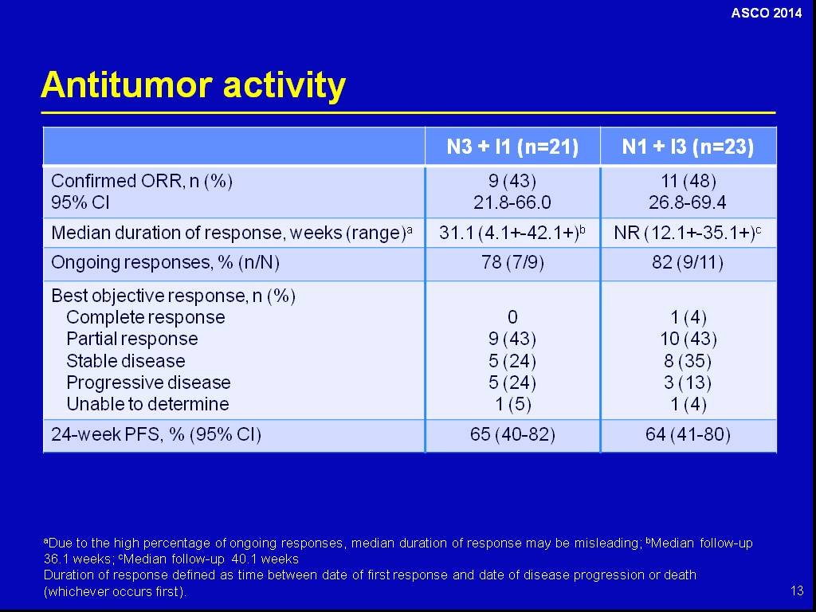
Antitumor activity
Nivolumab + Ipilimumab in
Metastatic Renal Cancer
Presented By Hans Hammers at 2014 ASCO Annual Meeting

Slide 23
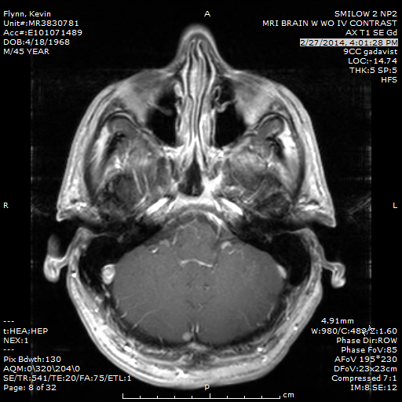
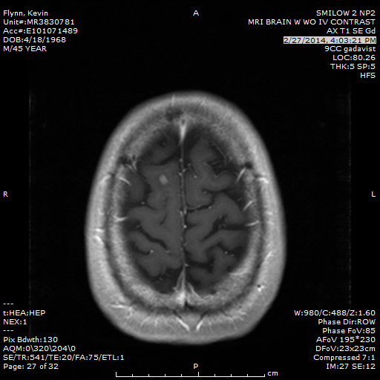
Patient Case 1
A patient with BRAF wild-type metastatic melanoma received checkpoint inhibitors as first-line therapy as part of CA209-067.
At week 12 there was marked regression of lung metastases and 2 new brain lesions
Week 13

Slide 24
Case 1: What would you do next?
WBRT + chemotherapy
SRS or gamma-knife RT to brain lesions, continue on immune therapy
SRS or gamma-knife RT to brain lesions, then observe
Continue immune therapy, repeat scans in 6 weeks including brain
Continue immune therapy, repeat scans in 12 weeks including brain
Observe, repeat scans in 6 weeks including brain
Observe, repeat scans in 12 weeks including brain

Slide 25
Results
Observe, repeat scans in
6 weeks including brain
SRS or gamma-knife
RT, continue on
immune therapy
Continue immune therapy,
repeat scans in 6 weeks
including brain

Slide 26
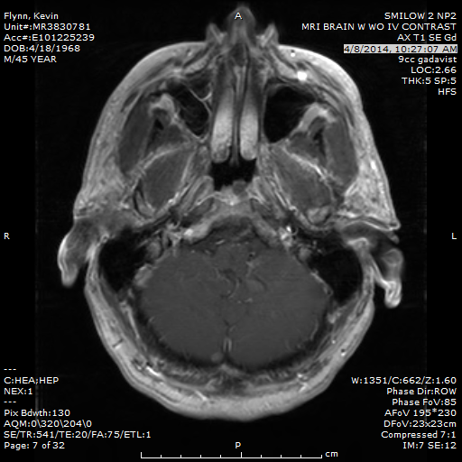
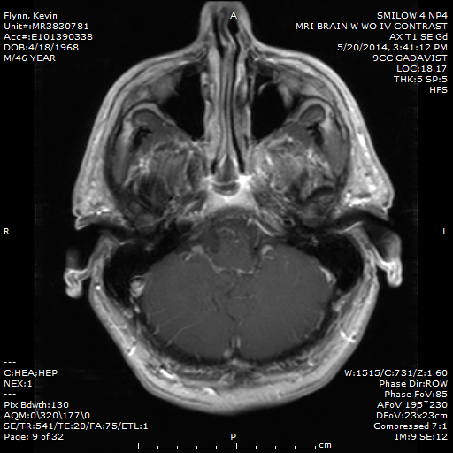
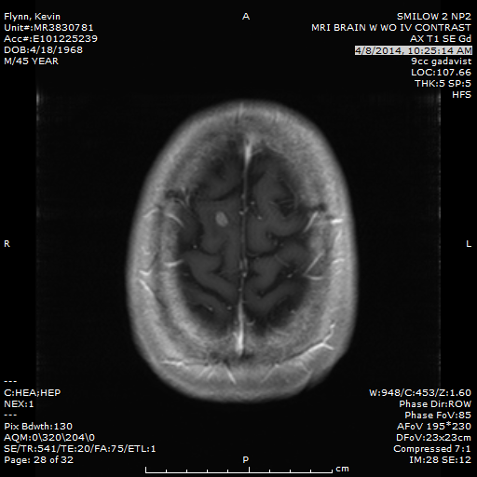
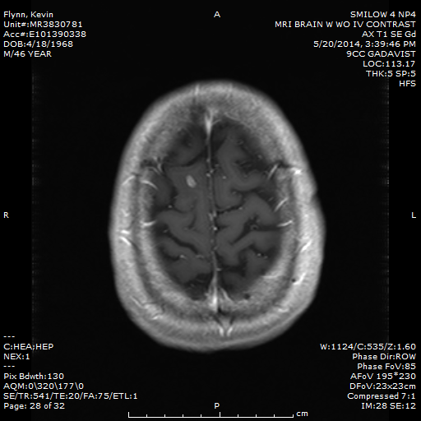
Left untreated, brain lesions grew slightly at week 19 and began to regress at week 25
Week 13
Week 19
Week 25

Slide 27
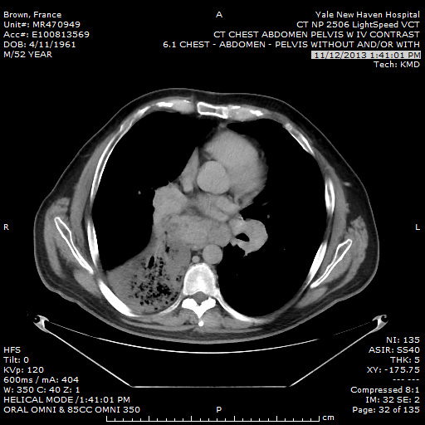
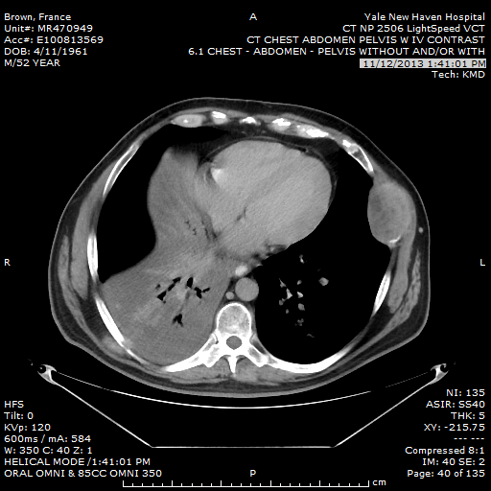
Case 2
Treatment-refractory mRCC
Prior RX: anti-PD1, HD IL-2, sunitinib, everolimus, axitinib, gemcitabine, RT
Primary in place; Mets to: brain, bone, LN, lung, adrenal, SQ, muscle
Received 4 doses of ipilimumab; week 12 scans showed mostly PD, slight reduction in adrenal met and primary tumor

Slide 28
Case 2: What would you do next?
Offer hospice
Offer pazopanib
Rescan in 8 weeks

Slide 29
Results

Slide 30
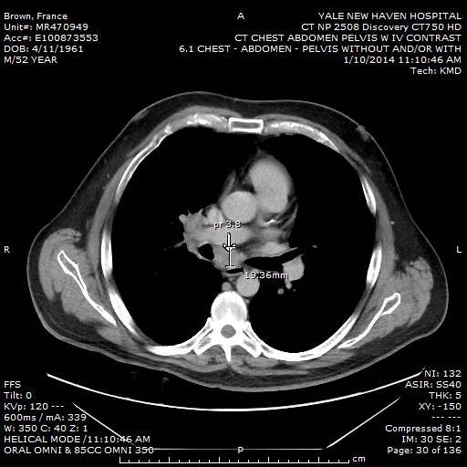
Response to Ipilimumab at Week 20 in Treatment-Refractory mRCC
Primary in place
Mets to: brain, bone, LN, lung, adrenal, SQ, muscle
Prior RX: anti-PD1, HD IL-2, sunitinib, everolimus, axitinib, gemcitabine, RT

Slide 31
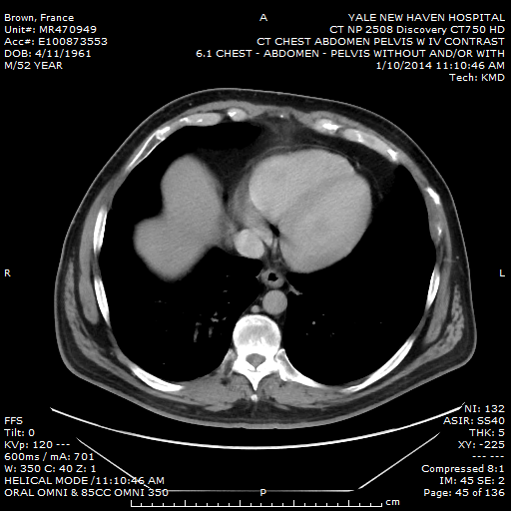
Response to Ipilimumab in Treatment-Refractory mRCC
Prior RX: anti-PD1, HD IL-2, sunitinib, everolimus, axitinib, gemcitabine, RT

Slide 32
Case 3
45 yo, ECOG PS = 0
Anal-mucosal melanoma, metastatic to multiple sites
Tumor contains mutation in c-kit (L576P)
Hx of hypothyroidism

Slide 33
Case 3: What would you offer as first-line therapy?
Chemotherapy
C-kit inhibitor (imatinib)
Ipilimumab
Anti-PD-1
Combination of ipilimumab and anti-PD-1
Comfort care

Slide 34
Results

Slide 35
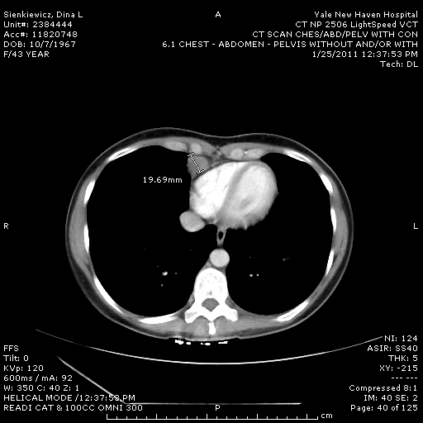
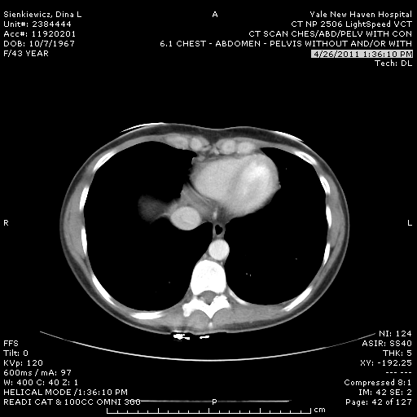
Case 3, cont
Metastatic melanoma from anal mucosal primary, response to ipilimumab 3 mg/kg + nivolumab 1 mg/kg

Slide 36
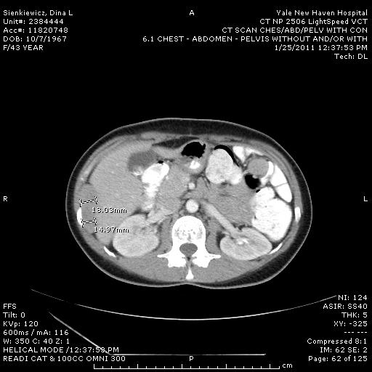
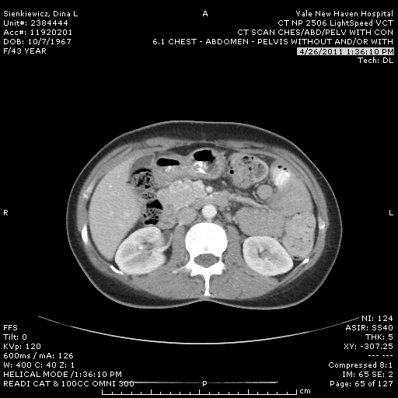
Case 3, cont
Metastatic melanoma from anal mucosal primary, response to ipilimumab 3 mg/kg + nivolumab 1 mg/kg

Slide 37
Case 3, cont
She received one dose of ipi+ nivo, complicated by posterior uveitis, and treated with high dose steroids
Treatment was stopped
Achieved complete response (developed extensive vitiligo)
After 2.5 years, developed mild anemia
At 3 years, scan showed large mass in gastric wall, otherwise NED – not resectable, Bx + for recurrent melanoma

Slide 38
Case 3: What would you offer next?
Chemotherapy
C-kit inhibitor (imatinib)
Ipilimumab
Anti-PD-1
Combination of ipilimumab and anti-PD-1
Comfort care

Slide 39
Results

Slide 41
Selection of Patients
Predictive biomarkers
Clinical features associated with response or resistance
Tumor burden and rate of disease progression
Kinetics of tumor response for immune therapy versus alternate therapies
Clinical contraindications (autoimmunity, drug interactions)
Potential for durable response with immune therapy versus alternate therapies (requirement for ongoing treatment)
Availability and toxicity/effectiveness of alternate therapies

Slide 42
Intra-tumoral PD-L1 Expression and Response to PD-1/PD-L1 Blockade

Slide 43
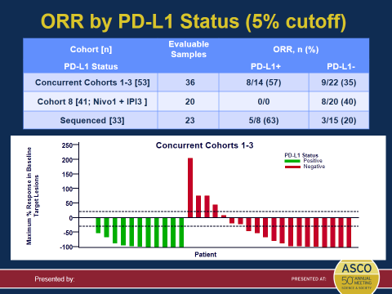
No Correlation of PD-L1 Tumor Expression with
Response to Ipilimumab + Nivolumab
Sznol M, et al. J Clin Oncol. 2014;32(5s): Abstract LBA9003.

Slide 44
Clinical Features Possibly Associated with Lower Immune Therapy Clinical Response
‘High’ tumor burden (melanoma, pembrolizumab)
CRP > 1.5x ULN (tremelimumab, melanoma)
High LDH
Baseline abs lymphocyte count < 1000 (ipilimumab, melanoma)

Slide 45
Pembrolizumab Confirmed ORR in Subgroups (Central Review, RECIST v1.1)
N
34%
N
34%
Overall
365
Overall
365
Gender
Metastasis stage
Male
223
Female
142
M0
47
Age
M1a
35
<65
221
M1b
62
≥65
144
M1c
213
ECOG PS
No. of prior therapies
0
261
1
104
0
81
LDH level
1
107
Normal
225
2
103
Elevated
135
≥3
74
Brain metastases
Yes
31
Prior systemic therapy
No
331
Chemotherapy
128
BRAF status
Immunotherapy
Mutant
85
100
Prior BRAFi
55
BRAF/MEKi
60
No prior BRAFi
30
Baseline tumor size
Wild type
276
<median
182
Prior IPI
163
No prior IPI
113
≥median
183
BRAFi, BRAF inhibitor; MEKi, MEK inhibitor.
Analysis cut-off date: October 18, 2013.
Ribas A, et al. J Clin Oncol. 2014;32(5s): Abstract LBA9000.

Slide 46
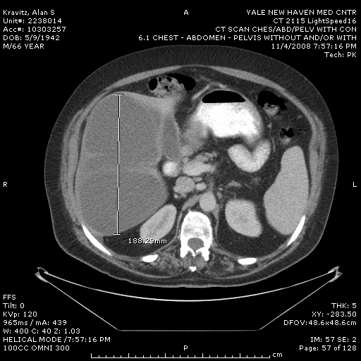
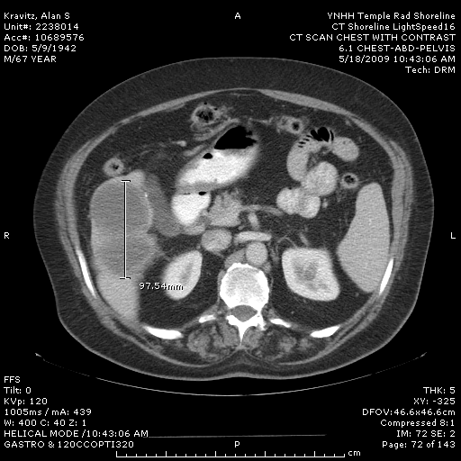
Metastatic Melanoma, Prior HD Il-2
Anti-PD1 1 mg/kg every other week x 2 years
Negative PET CT at 6 months
Improving PR at 5.5 years

Slide 47
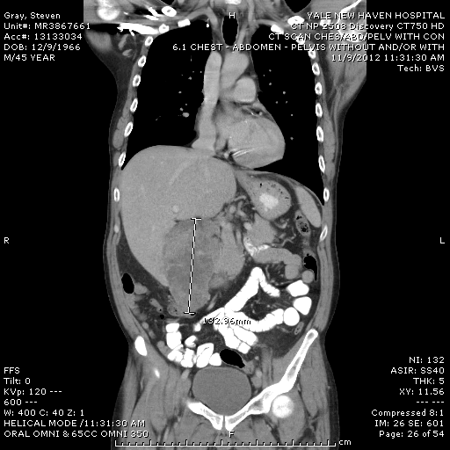
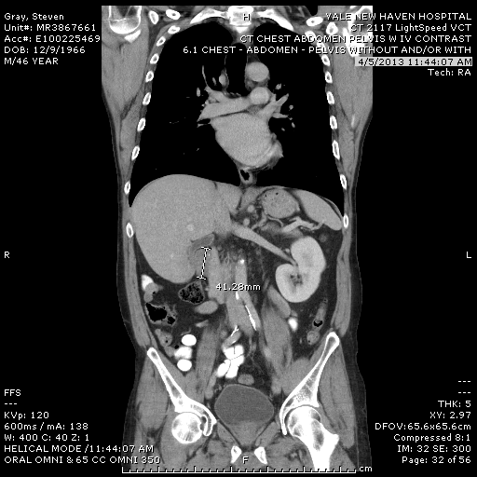
Clear cell renal carcinoma, histologic grade 4, PD-L1 tumor expression+:
Prior excellent mixed response to HD IL-2, began anti-PD-L1 20 mg/kg q3w on 12/9/12,
No AEs (liver lesion also regressed, not shown) – slide 1

Slide 48
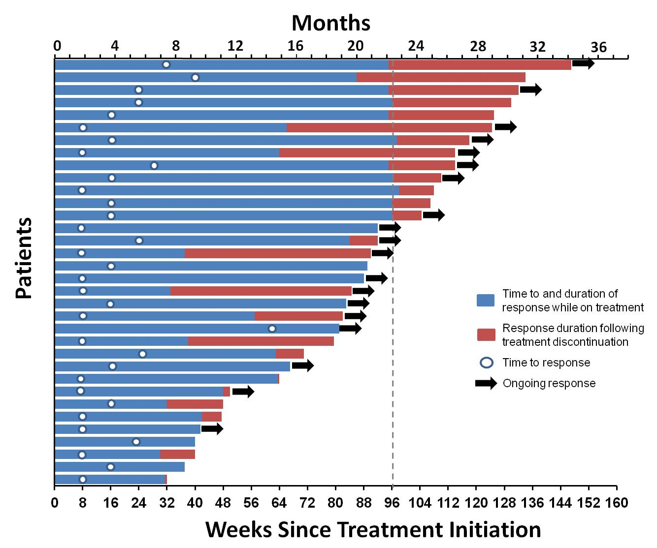
Response Characteristics in Patients with Melanoma Receiving Nivolumab
Longest follow-up of any PD-1 pathway inhibitor; MEL pt enrollment: November 2008 through January 2012
Responses ongoing in 19/34 (56%) responders at time of analysis
52% (11/21) of responding pts who discontinued therapy for reasons other than PD responded for ≥24 weeks
64% (7/11) remained in response from 24-56 weeks
44% (15/34) of responding patients showed a response at first tumor assessment (8 weeks)
Median DOR 22.9 months
Hodi FS, et al. J Clin Oncol. 2014;32(5s): Abstract 9002.

Slide 49
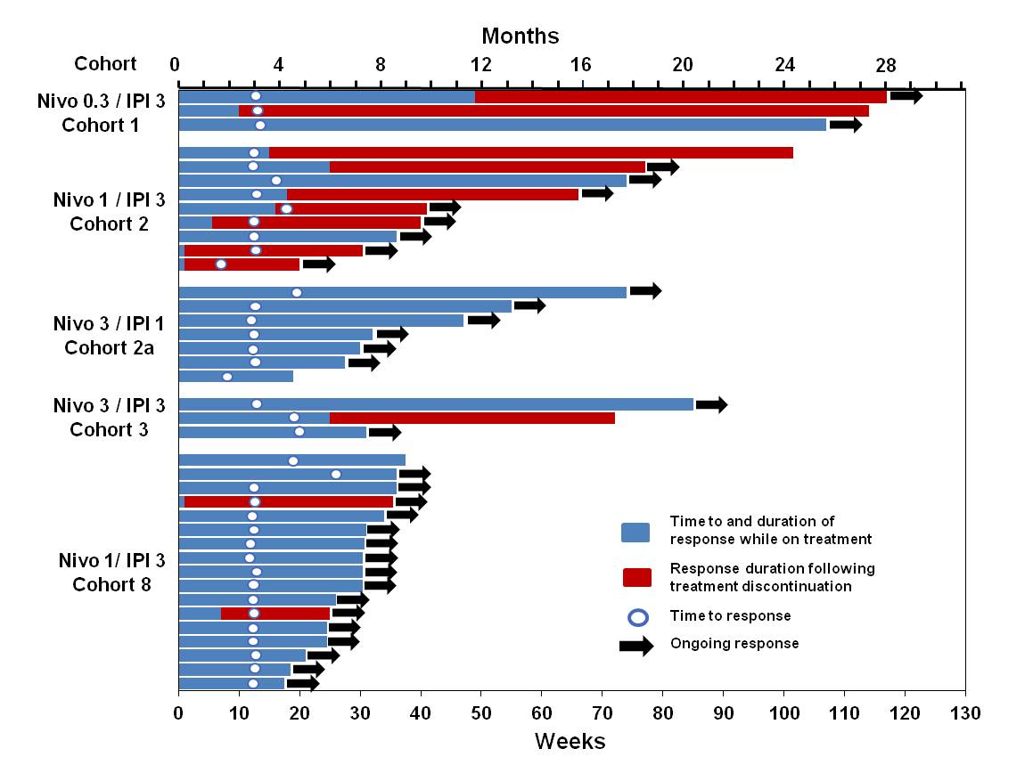
Ipilimumab+Nivolumab Characteristics of Response
Median duration of response in Cohorts 1-3 and cohort 8 not reached
18/22 responses ongoing
Sznol M, et al. J Clin Oncol. 2014;32(5s): Abstract LBA9003.

Slide 50
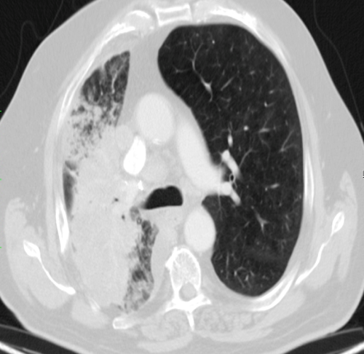
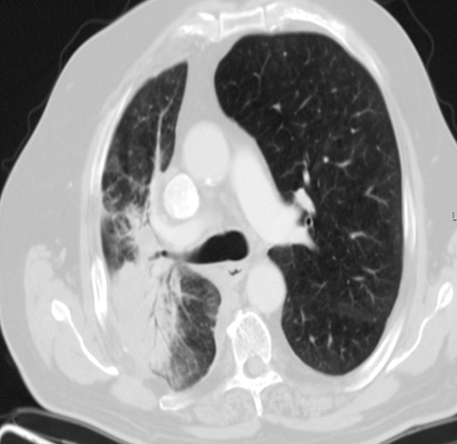
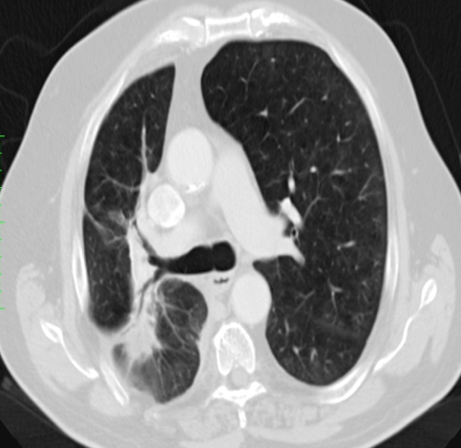
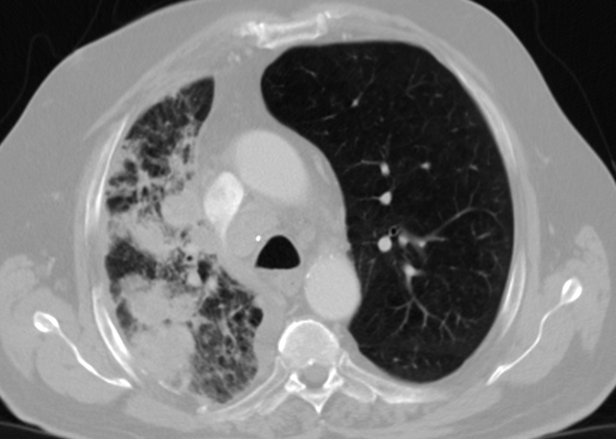
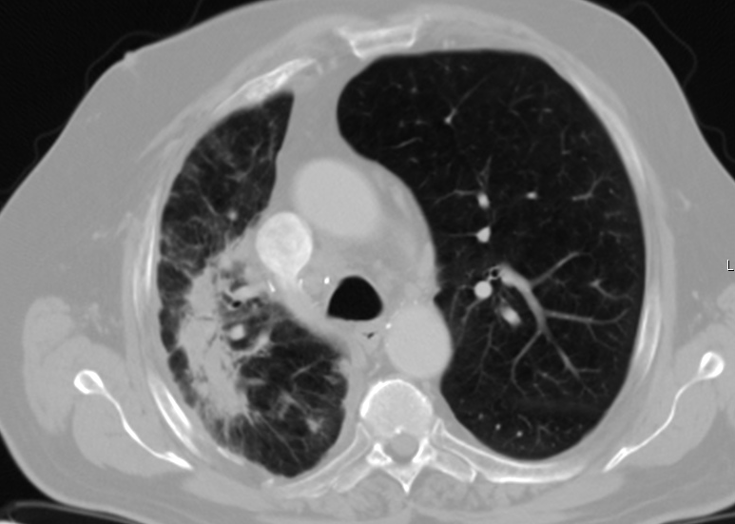
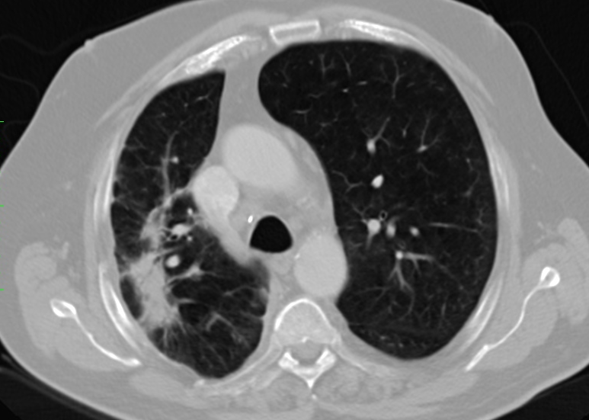
Rapid Response in an NSCLC Patient Treated With MPDL3280A Monotherapy
Baseline
Post C2 (Week 6)
Post C4 (Week 12)
64-year-old male with squamous NSCLC s/p R lobectomy, cisplatin + gemcitabine, docetaxel, erlotinib, PD-L1 positive

Slide 51
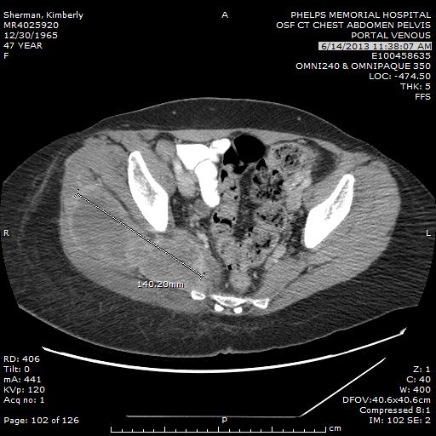
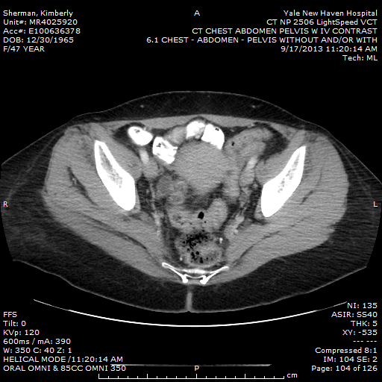
Cohort 8, Ipilimumab + Nivolumab
Response at 12 weeks
Prior therapy with HD-IL2, multiple resections, Vemurafenib, and RT;
LDH > 2000 at baseline; LDH nearly normal within 3 weeks

Slide 52
no
Eligible for Immunotherapy
GKS/SRS
Brain mets
yes
Yes
No
C-kit mutation
Ckit inhibitor
PD
BRAF mutation
Anti-PD1
Anti-CTLA-4
High dose IL-2
Adoptive Immunotherapy
Other Investigational Immunotherapy Trials
mNRAS
Yes
Yes
MEKi + CDK4i
BRAFi + MEKi
BRAFi + other
ERKi
NO mutation or PD
with targeted agents
Phase 1
Other targeted Rx
Anti-angiogenesis
Supportive care
Chemotherapy
Yale Cancer Center Melanoma
Treatment Algorithm

Slide 53
Slide unavailable

Slide 54
Management of Adverse Events
Never use prophylactic immune suppression
Adverse events can involve any organ system
Most common: skin, GI (colitis/enteritis), liver, endocrine (thyroid, pituitary)
Education of patient and staff is critical
Steroids are cornerstone of management, but when to start, how much ,and for how long depend on the event
Algorithms are available to guide management

Slide 55
Potential Mistakes
Start steroids too soon
Start steroids too late
Underdose steroids
Stop steroids too soon
Don’t recognize severe colitis or more diffuse GI involvement
Don’t recognize hypophysitis
Don’t monitor labs (for LFT abnormalities)
Don’t recognize unusual iRAEs (pneumonitis)
Don’t monitor for serial iRAEs
Don’t monitor after initial response to steroids
Don’t consider use of anti-TNF agent or mycophenolate for adverse events unresponsive to steroids

Slide 56
Conclusions
Immune therapies, particularly checkpoint inhibitors, demonstrate activity in various malignancies
Responses to immune therapy can be durable and may not require continued therapy
Clinical features and biomarkers may enrich for response but do not identify all responders
Weigh relative risk/benefit in any individual patient
Value of specific biomarkers may diminish in combinations
Optimal sequence with other therapies for optimal outcome not known
Immune related adverse events are ‘different’ but are manageable
Appropriate use of steroids and other immune suppressive agents
Require education of both patient and staff

